Slide 1
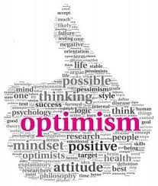
OPTIMISM
Hopefulness and confidence about the future or the success of something.

Slide 2
Optimism is a form of positive thinking that includes the belief that you are responsible for your own happiness, and that more good things than bad will continue to happen to you.
Optimists believe that bad or negative events are temporary.
People who are optimists tend to focus on the positive side of things rather than the negative.
For example, an optimistic female who is dumped by her boyfriend does not blame herself, but instead may believe that the relationship just wasn't meant to be.

Slide 3
Optimism comes from the Latin word optimus, meaning "best," which describes how an optimistic person is always looking for the best in any situation and expecting good things to happen.
Optimism is the tendency to believe, expect or hope that things will turn out well.
Even if something bad happens, like the loss of a job, an optimist sees the silver lining.

Slide 4
Optimists believe that their own actions result in positive things happening, that they are responsible for their own happiness, and that they can expect more good things to happen in the future.
Optimists don’t blame themselves when bad things happen.
They view bad events as results of something outside of themselves. I didn’t blame myself for losing my job, but saw it as a business decision that had nothing to do with me personally.

Slide 5
"People might be optimistic for a variety of reasons.
For example, twin studies show that about 25% of optimism is heritable, which does mean that some of it can be controlled by thinking patterns and things that we do by ourselves, but also a lot of it might be due to social and structural factors,"

Slide 6
For instance, how much warmth and attention your parents gave you during childhood have been associated with levels of optimism later in life.
The opposite of optimism is known as pessimism.

Slide 7
Pessimists think the opposite way.
They blame themselves for the bad things that happen in their lives and think that one mistake means more will inevitably come.
Pessimists see positive events as flukes that are outside of their control—a lucky streak that probably won’t happen again.

Slide 8
Because of their thought processes, optimists have much brighter futures.
A bad circumstance or event is taken in stride, viewed as a temporary setback—not a permanent way of life.
Even if something bad happens today, a positive thinker believes that good things will come again in the future.

Slide 9
Optimists tend to share several other positive characteristics that increase overall happiness and promote health, while reducing depression and chronic stress:
They think about, reflect on, and emphasize the good things in life.
They are grateful and thankful for all their blessings.
They don’t complain when something bad happens.
They feel that nothing can hold them back from achieving success and reaching their goals.
They are confident that the world offers plenty of opportunities for everyone to succeed.
Notes:
They believe in abundance.

Slide 10
Optimism is a skill of emotional intelligence, which translates to a better career and greater success in life.
Life is too short to be miserable, so start turning your thinking around!
The power of positive thinking can advance your prospects for work, relationships and other life experiences.

Slide 11
Learned optimism

Slide 12
Learned optimism is very much a positive psychology concept; it is the idea in positive psychology that a talent for joy, like any other, can be cultivated. it’s the opposite of Learned helplessness: a phenomenon whereby individuals believe they are incapable of changing their circumstances after repeatedly experiencing a stressful event

Slide 13
Why is it important to be optimistic?
Optimism is a key to success.
It gives meaning to our life.
Optimism, on the one hand, allowing one to have an optimistic outlook on life, lets a person gain confidence.
On the other hand, it brings positive change to one's mind, so that he can overcome his own problems successfully.

Slide 14
Positive psychology and Well-being
The emerging field of positive psychology studies the positive impact that optimism has on mental health.
Other research shows that optimism may be good for physical health too—optimists are sick less and live longer than pessimists.
Apparently, a positive outlook on life strengthens the immune system (and the body's defenses against illness), cardiovascular system (optimists have fewer heart attacks), and the body's ability to handle stress.

Slide 15
Benefits of Optimism
More than five decades of research have found that optimism is a potent health tonic.
Optimistic people remain healthier and live longer.
They have better cardiovascular health—even after risk factors are controlled for, stronger immune function, and lower levels of stress and pain.
And healthy people who are optimistic report feeling better than equally healthy people who are pessimistic.
When optimistic people encounter an adverse health event like coronary artery bypass surgery or orthopedic surgery, they bounce back faster.

Slide 16
Dog Experiment of Learned Helplessness

Slide 17
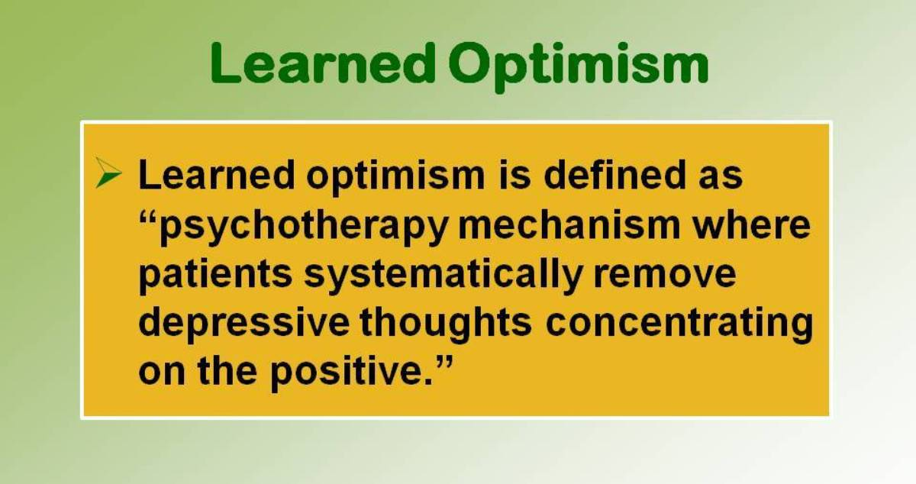

Slide 18
Learned helplessness
Learned helplessness, in psychology, a mental state in which an organism forced to bear aversive stimuli, or stimuli that are painful or otherwise unpleasant, becomes unable or unwilling to avoid subsequent encounters with those stimuli, even if they are “escapable,” presumably because it has learned that it cannot escape ...
Notes:
https://video.search.yahoo.com/search/video;_ylt=AwrgCqSewC9eLDAAoXBXNyoA;_ylu=X3oDMTE0Y3FkOGJxBGNvbG8DZ3ExBHBvcwMxBHZ0aWQDQjkzMTdfMQRzZWMDcGl2cw--?p=learned+helplessness+dog+experiment&fr2=piv-web&fr=mcafee#id=13&vid=a05fd29509646716ec57584ab9fdb90b&action=view

Slide 19
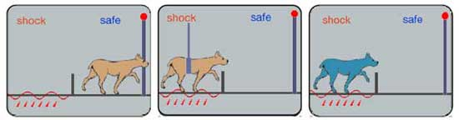

Slide 20
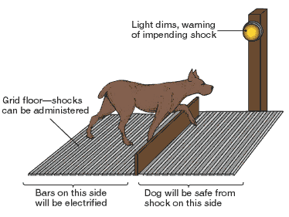

Slide 21
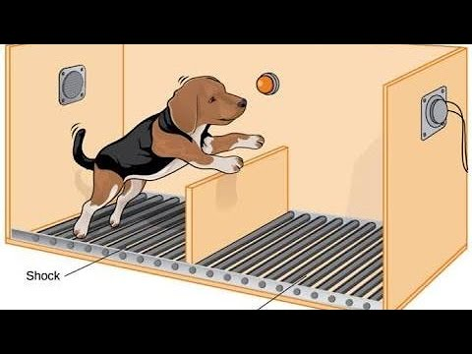
Notes:
https://video.search.yahoo.com/search/video;_ylt=Awr9ImBfwS9eK6YAbwNXNyoA;_ylu=X3oDMTE0Y3FkOGJxBGNvbG8DZ3ExBHBvcwMxBHZ0aWQDQjkzMTdfMQRzZWMDcGl2cw--?p=dog+shock+experiment+for+learned+helplessness&fr2=piv-web&fr=mcafee#id=1&vid=b3250f7d14c4b81d675891b07b6f3ee9&action=view

Slide 22
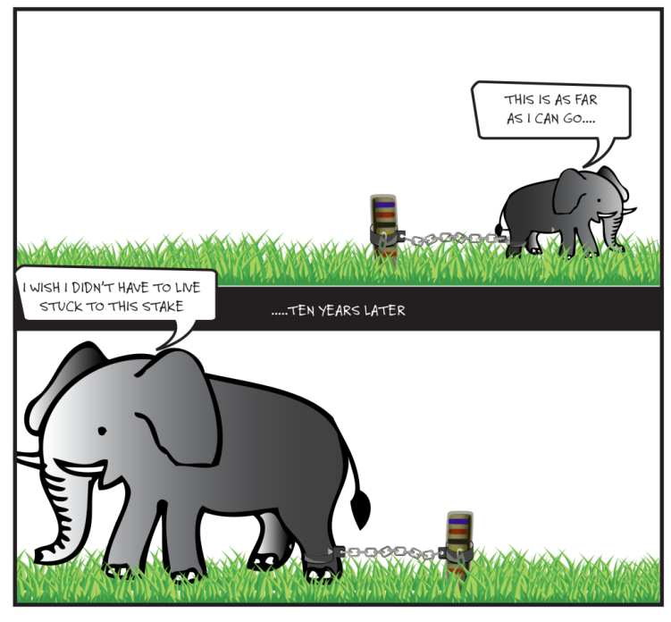

Slide 23
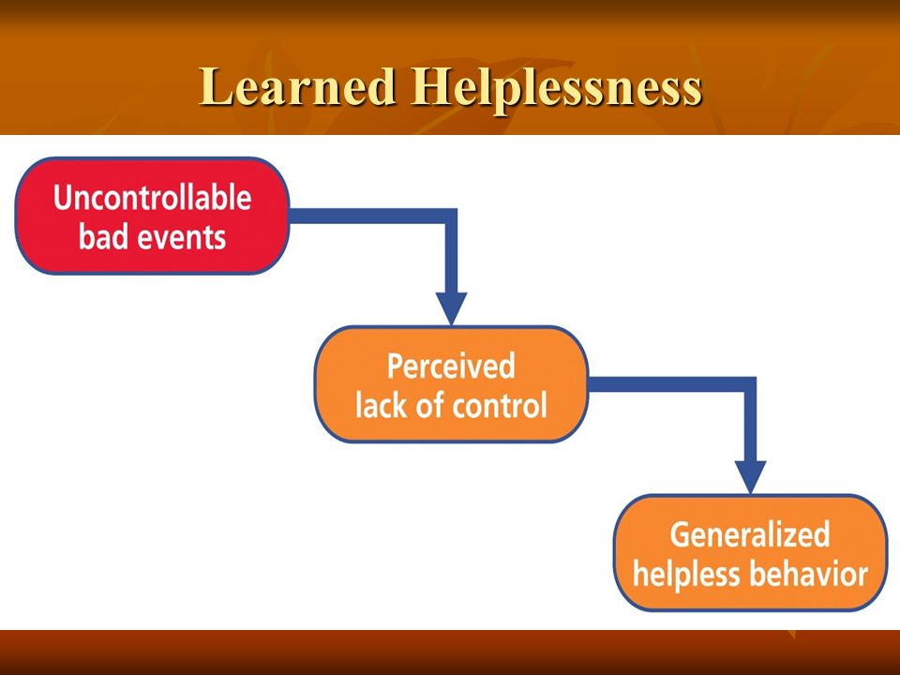

Slide 24
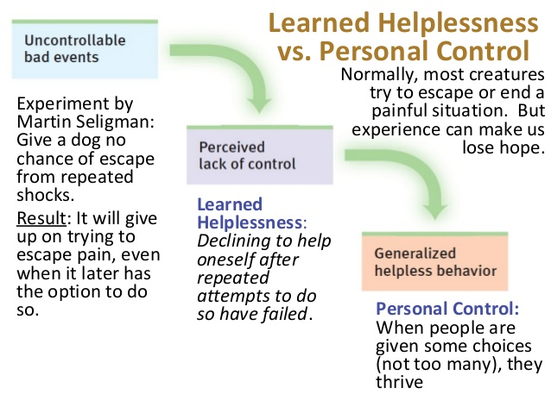

Slide 25
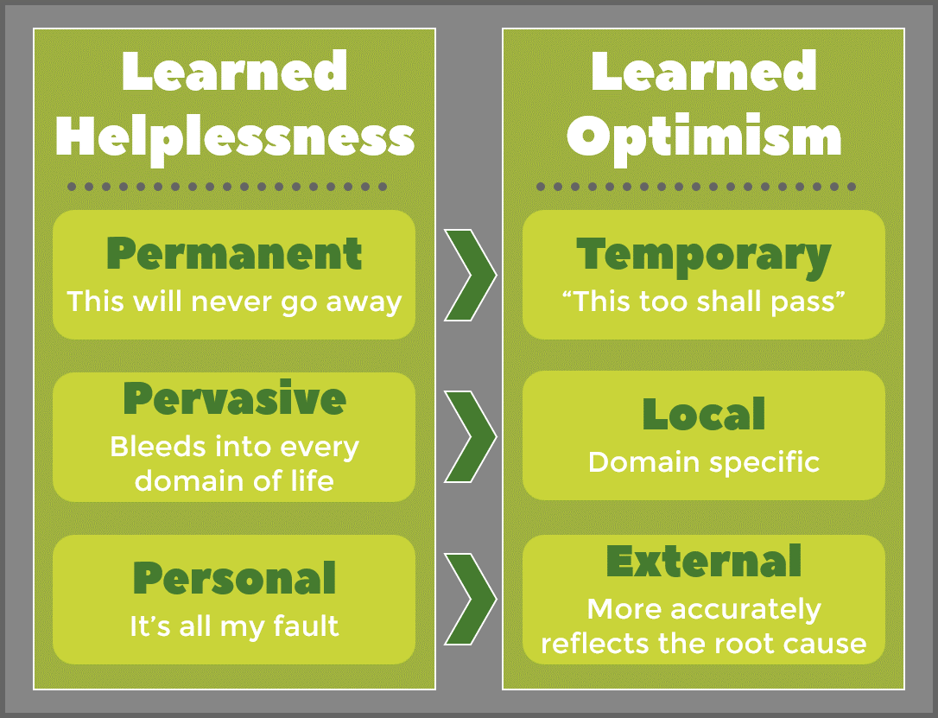

Slide 26
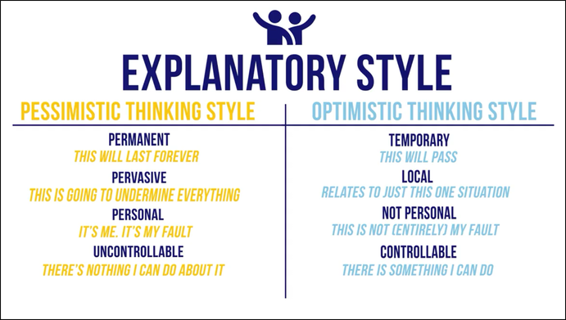
Learning optimism is done by consciously challenging any negative self talk.

Slide 27
Martin’s Method
Seligman contends that anyone can make use of learned optimism, regardless of how pessimistic a person’s outlook.
Not all pessimists are the same.
So, as a first step a person’s base level of optimism must be determined.
As a means to get some hard data, Seligman developed a test.

Slide 28
If your base level of optimism isn’t very high, it means that you are at the level where learned optimism can be the most beneficial.
The next step is to assess people’s reaction to negative situations. To do this, Seligman created a system based off Albert Ellis’ ABCs. His system, ABCDE, adds two more steps.
The first three letters stay the same: Adversity, Belief, Consequence. The additional two in the new system stand for D-Disputation and E-Energy.

Slide 29
Adversity
This is the event that causes stress.

Slide 30
Belief
This is how a person interprets the event

Slide 31
Consequence
The resulting action from the belief caused by the adversity.

Slide 32
Disputation
Using evidence to challenge negative thoughts from
A-C.

Slide 33
Energizing
Once a person is able to condition themselves into positive thoughts and behaviors in response to A, B, C, D will eventually lead to a person feeling more energized.

Slide 34
HOW TO OVERCOME LEARNED HELPLESSNESS
Learned helplessness is caused by depression and fear that you are feeling that results in uncontrolled of certain things.
To help you overcome with this, you should remove all the worries and negativities that you are experiencing in life.
It is also necessary that once in while you should also give yourself a break especially during stressful work.
Feel free to talk with others.

Slide 35
Always be your friends and family so that you will learn how to get communicate with others.
Just always feel relax, comfortable and let go of your worries.
You will be at peace if you will remove all those burdens that you are feeling.
Try to be more expose in your environment and always be willing to try new things that will simply make you more enjoyed.
You can live a happy life if you are free from all worries and if you know how to handle different situations calmly.

Slide 36
How did you explain your circumstances to yourself?
  Perhaps you shrugged your setback off as temporary bad luck.
  Or maybe you blamed yourself for the setback.
The way that you routinely explain your life circumstances to yourself is called your explanatory style.

Slide 37
Seligman begins by identifying the three types of happiness of which our favorite psychology grab-bag term is composed:
For the ‘Pleasant Life,’ you aim to have as much positive emotion as possible and learn the skills to amplify positive emotion.
For the ‘Engaged Life,’ you identify your highest strengths and talents and recraft your life to use them as much as you can in work, love, friendship, parenting, and leisure.
For the ‘Meaningful Life,’ you use your highest strengths and talents to belong to and serve something you believe is larger than the self.

Slide 38
